Slide 1

E-BOOK
Ministry of Women and Child Development
Government of India
http://wcd.nic.in

Slide 2
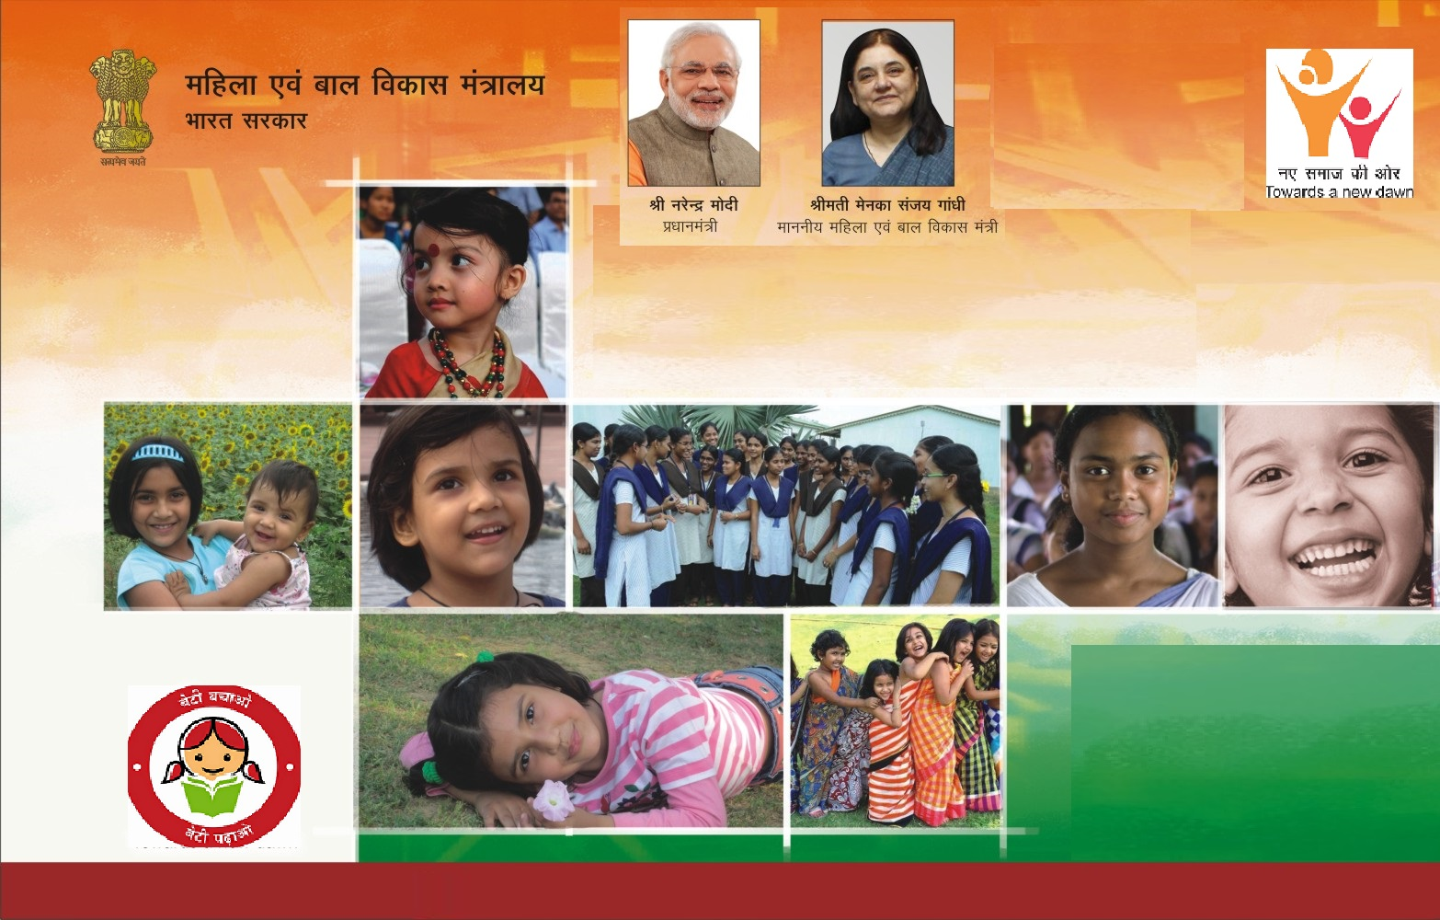
Ministry of Women and Child Development

Slide 3

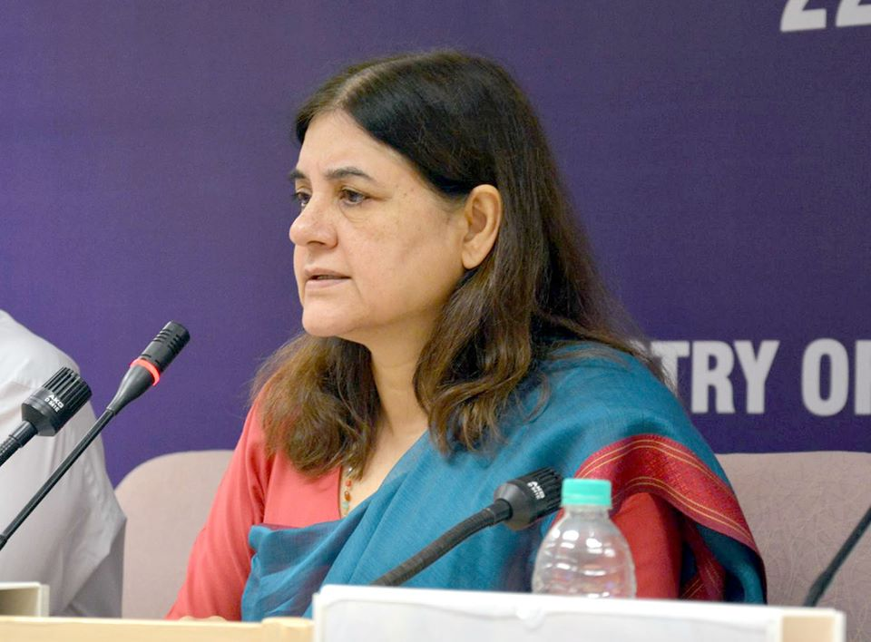
Ministry of Women and Child Development
VISION
“Empowered women living with dignity and contributing as equal partners in development in an environment free from violence and discrimination and, well-nurtured children with full opportunities for growth and development in a safe and protective environment”
MISSION
Promoting safety, social & economic empowerment of women and protection, care and development of children through cross cutting policies, programmes and schemes.
The Department of Women and Child Development was set up in the year 1985 as a part of the Ministry of Human Resource Development to give the much needed impetus to the holistic development of women and children. With effect from 30.01.2006, the Department has been upgraded to a Ministry.

Slide 4

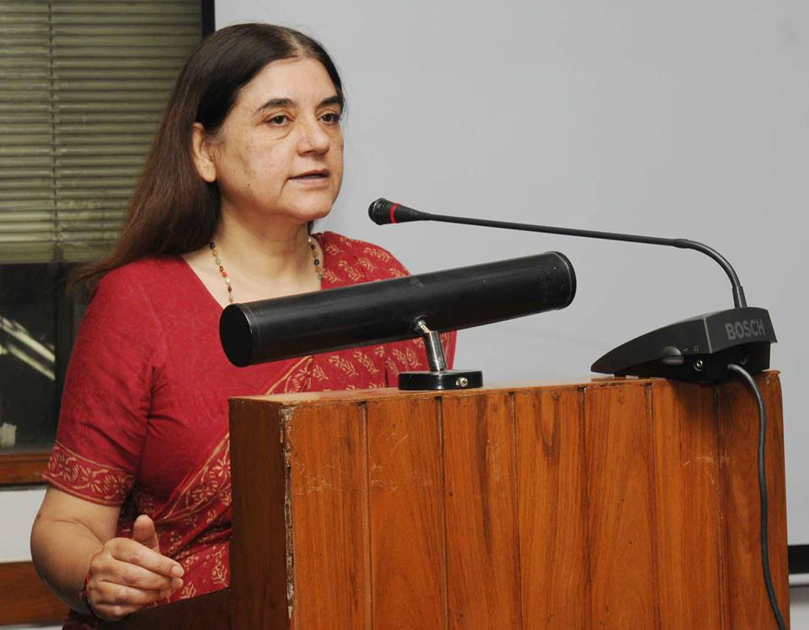
Our Commitment Addressing the needs of over 70% of people
Children
Beti Bachao Beti Padhao
Women
Survival, development, protection & participation
Nutrition
Addressing trafficking, missing children, sexual abuse
Tackling juvenile crimes
Strengthening child protection systems
Safety & Security
Health: Nutrition & Pregnancy
Skill development
Removing Gender disparity
Restructuring RMK
Empowerment
Better working conditions for Anganwadi Workers
MINISTRY OF WOMEN AND CHILD DEVELOPMENT
GOVERNMENT OF INDIA

Slide 5

Achievements of MWCD
A Bill to amend Juvenile Justice Act introduced in the Parliament
Its salient features are as under:
Provision to get boys in the age group of 16-18 years, who have committed heinous crimes, tried as an Adult on the recommendation of Juvenile Justice Board.
Amendment to existing Rules for adoption of children and revamping of the national website for adoption procedure
CARINGS – which has made the adoption process easier. Sensitization workshops are being organized all over India in 2015.
New Rules for easy and faster adoption of children.
Introducing a new scheme for foster care for the first time in India to enable older children to get family based care till they get formally adopted.
MINISTRY OF WOMEN AND CHILD DEVELOPMENT
GOVERNMENT OF INDIA

Slide 6
Achievements of MWCD
Detailed proposal for establishing One Stop Crisis centres for women affected by violence submitted to Cabinet for consideration.
Detailed proposal for establishing One Stop Crisis centres for women affected by violence in each district of the country formulated and submitted to Cabinet for consideration.
All India women Helpline
All India women Helpline being revamped and to be dove-tailed along with the one stop crisis centre.
MINISTRY OF WOMEN AND CHILD DEVELOPMENT
GOVERNMENT OF INDIA

Slide 7

Achievements of MWCD
Strengthening and restructuring of National Commission for Women
Strengthening and restructuring of National Commission for Women for which a detailed proposal along with an amendment Bill to the NCW Act submitted to Cabinet.
Support to Training and Employment Programme for Women
Support to Training and Employment Programme for Women (STEP) formulated as a new scheme for providing financial assistance to NGOs which undertake capacity building of women in various skills.
Revamping of Child- line Scheme
Child-line scheme for children in assistance has been revamped and is being expanded to reach to 500 cities in the country. The revised scheme enables citizens to participate for assisting children in distress.
MINISTRY OF WOMEN AND CHILD DEVELOPMENT
GOVERNMENT OF INDIA

Slide 8
Achievements of MWCD
Guidelines for protection of the runaway children
New guidelines for protection of the runaway children (who generally use railways) being formulated in consultation with Ministry of Railways.
TRACKCHILD-Public website for Missing Children
Public website for Missing Children being re-vamped for increased citizens participation and effectiveness.
Standard operating procedures and parameters for assessment for the women and children institutions
Standard operating procedures and parameters for assessment for the women and children institutions assisted by the Ministry being formulated. All institutions will be assessed periodically against these parameters
MINISTRY OF WOMEN AND CHILD DEVELOPMENT
GOVERNMENT OF INDIA

Slide 9
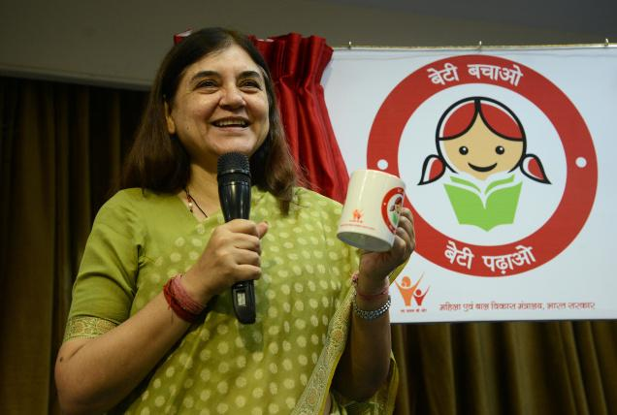
Achievements of MWCD
Beti Bachao-Beti Padhao Scheme
Issue of decreasing child sex ratio being addressed through a new Beti Bachao-Beti Padhao scheme with following features:
Targeted for 100 districts with worst child sex ratio
Coordinated delivery of services by different ministries
Sensitization of communities for moving towards institutionally supported births
MINISTRY OF WOMEN AND CHILD DEVELOPMENT
GOVERNMENT OF INDIA

Slide 10
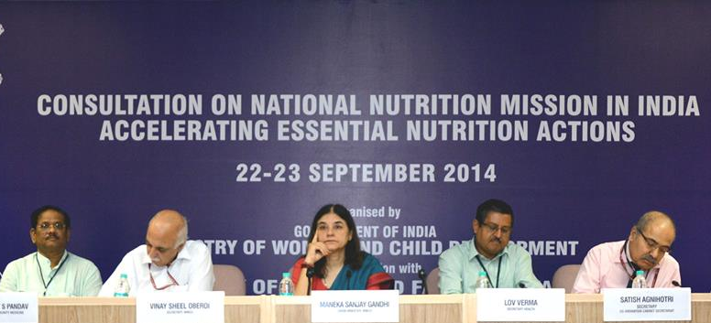
Achievements of MWCD
National Nutrition Mission
New Mission to tackle malnutrition being launched with following features:
Comprehensive training to Anganwadi workers
Use of technology (weighing machines, IT enable services) to identify and monitor malnutritioned children on real time basis.
Improving the quality of Take Home Rations
Sneh Shivirs for participation of communities in tackling the problem of malnutrition
MINISTRY OF WOMEN AND CHILD DEVELOPMENT
GOVERNMENT OF INDIA

Slide 11
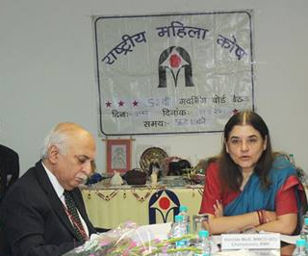
Achievements of MWCD
Revamping and restructuring of Rashtriya Mahila Kosh to it enable to function as a lead institution to help women to become micro entrepreneurs
Restructuring of Rashtriya Mahila kosh
Restructuring of Rashtriya Mahila Kosh
MINISTRY OF WOMEN AND CHILD DEVELOPMENT
GOVERNMENT OF INDIA

Slide 12
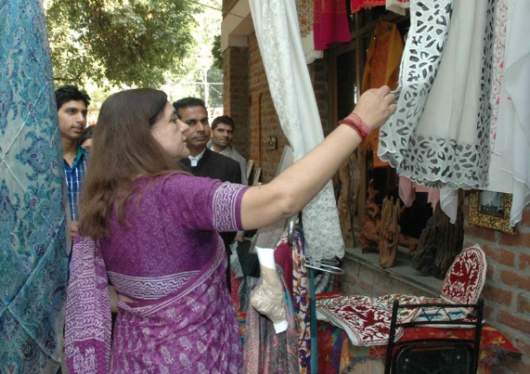
Achievements of MWCD
Organized an extremely successful women entrepreneurs Mela which linked women artisans and crafts persons from all over India to direct customers. About five lacs persons visited this 2- week event in Delhi. Similar melas to be organized all over the country in 2015.
Women Entrepreneurs Mela
“Women of India” Outlets
Proposal being formulated for creation of “Women of India” outlets that will link women artisans and craft persons directly to the customers.
Women Entrepreneurs Mela
MINISTRY OF WOMEN AND CHILD DEVELOPMENT
GOVERNMENT OF INDIA

Slide 13
Achievements of MWCD
Expansion of Matritva Sahyog Yojana
Matritva Sahyog Yojana for assisting pregnant and lactating mothers being expanded in a phased manner to cover all districts of the country.
Revamping of SABLA Scheme
SABLA scheme being re-vamped to cover all out of school girls for providing life skills and supplementary nutrition.
Revamping of National Policy for Women, 2001
National Policy for Women, 2001 being revamped for replacement with a new policy in 2015.
Public grievance Cell
Public grievances all along with a dedicated email address created in the Ministry to handle grievances and coordination with different agencies of Central/ State Government for redressal
Online monitoring of progress of ICDS scheme
Online monitoring of progress of ICDS scheme in the states started.
MINISTRY OF WOMEN AND CHILD DEVELOPMENT
GOVERNMENT OF INDIA

Slide 14

Achievements of MWCD
Bal Swachhta Abhiyan
Bal Swachhta Abhiyan launched through the network of 14 lacs anganwadis be include children in the Swachh Bharat Abhiyan.
State-of-the-art Laboratories
Proposal for creation of 4 state-of-the-art laboratories to undertake on-going quality testing of supplementary nutritional products under ICDS/ National Nutrition Mission.
MINISTRY OF WOMEN AND CHILD DEVELOPMENT
GOVERNMENT OF INDIA

Slide 15
MORE ABOUT
Ministry of Women and Child Development

Slide 16
LEGAL FRAMEWORK
As a nodal Ministry for the advancement of women and children, the Ministry enacts/amends legislation, formulates plans, policies and programmes, guides and coordinates the efforts of both Governmental and Non-Governmental organisations working in the field of Women and Child Development. The various acts administered by the Ministry are:
Women related Acts
The Sexual Harassment of Women at Workplace (Prevention, Prohibition and Redressal) Act, 2013
Protection of Women from Domestic Violence Act, 2005
National Commission for Women Act, 1990
The Commission of Sati (Prevention) Act, 1987
The Indecent Representation of Women (Prohibition) Act, 1986
The Dowry Prohibition Act, 1961/1986
The Immoral Traffic (Prevention) Act, 1956/1986
Criminal Law Amendment Act 2013 (Enacted by MHA. New provisions penalizing acid attack, sexual harassment, voyeurism and stalking ; increased penalty for gang-rape and causing serious injury to victim; Provision for rape expanded and pre-medical treatment to victims)
Child related Acts
Child Marriage Prohibition Act, 2006
The Protection of Children from Sexual Offences Act, 2012
The Commissions for Protection of Child Rights Act, 2005
The Juvenile Justice (Care and Protection of Children) Act, 2000 as amended 2006 & 2011
The Infant Milk Substitute, Feeding Bottles and Infan Food Act, 1992/2003
t
MINISTRY OF WOMEN AND CHILD DEVELOPMENT
GOVERNMENT OF INDIA

Slide 17

WCD Schemes
WOMEN SCHEMES
CHILDREN SCHEMES
MINISTRY OF WOMEN AND CHILD DEVELOPMENT
GOVERNMENT OF INDIA

Slide 18
WCD Schemes
WOMEN SCHEMES
SWADHAR GREH
HOSTEL FOR WORKING WOMEN ( WWH)
SUPPORT TO TRAINING AND EMPLOYMENT PROGRAMME (STEP)
COMPREHENSIVE SCHEME FOR COMBATING TRAFFICKING (UJJAWALA)
INDIRA GANDHI MATRITVA SAHYOG YOJANA (IGMSY)
SCHEME FOR EMPOWERMENT OF ADOLESCENT GIRLS – SABLA
BETI BACHAO BETI PADHAO (BBBP)
NATIONAL MISSION FOR EMPOWERMENT OF WOMEN (NMEW)
HIGH LEVEL COMMITTEE FOR WOMEN
GENDER BUDGETING
CHILDREN SCHEMES
MINISTRY OF WOMEN AND CHILD DEVELOPMENT
GOVERNMENT OF INDIA

Slide 19



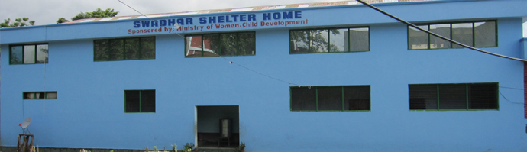
SWADHAR Scheme
Swadhar Scheme was launched in year 2001-02 as a Central Sector Scheme for the benefit of women in difficult circumstances.
Photo Gallery
Audio/Video
Achievements
OBJECTIVES OF THE SCHEME
to provide primary need of shelter, food, clothing and care to the marginalized women/girls living in difficult circumstances who are without any social and economic support;
to provide emotional support and counselling to such women
to arrange for specific clinical, legal and other support for women/girls in need; and
to provide for help line or other facilities to such women in distress.
WWH
STEP
UJJAWALA
IGMSY
SABLA
BBBP
NMEW
Swadhar scheme is being implemented through implementing agencies i.e. Social Welfare/Women and Child Welfare Departments of State Governments, Women’s Development Corporations, Urban Local Bodies, reputed Public/Private Trusts or Voluntary Organizations.
SWADHAR Webpage
There are 311 Swadhar Shelter Homes and 232 Helplines functioning across the country as on 31st March, 2014. During 2013-14,the total number of beneficiaries covered under the Scheme is 8234.
MINISTRY OF WOMEN AND CHILD DEVELOPMENT
GOVERNMENT OF INDIA

Slide 20
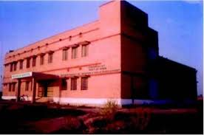
Working Women Hostel
The Scheme introduced in 1972-73 as a Central Sector Scheme envisages provision of safe and affordable Hostel accommodation to Working, Single Working Women, Women Working at places away from their hometown and for women being trained for employment. Under the Scheme Government provides financial assistance for construction of Hostel / Building on Public Land (75% of the total cost of construction), for rent of hostels run in rented premises. Provision of day care centre for children of the inmates of the Hostel is an important aspect of the scheme.
Photo Gallery
Audio/Video
Achievements
SWADHAR
STEP
UJJAWALA
IGMSY
SABLA
BBBP
NMEW
Working Women are entitled to hostel facilities provided their gross income does not exceed Rs. 50,000/- consolidated (gross) per month in metropolitan cities, or Rs. 35,000/- consolidated (gross) per month, in any other place. The fund under the scheme is released to the implementing agencies which include NGOs also.
Scheme of Working Women’s Hostel
912 hostels and 342 day care centers have been sanctioned upto November, 2014 which provide accommodation to 68,371 women/girls and 9,197 children.
MINISTRY OF WOMEN AND CHILD DEVELOPMENT
GOVERNMENT OF INDIA

Slide 21
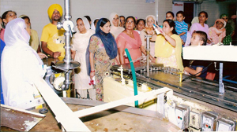
Support to Training and Employment Programme for Women (STEP)
Photo Gallery
Audio/Video
Achievements
STEP Scheme was launched as Central Sector Scheme in 1986-87 with a view to make significant impact on women by upgrading skills for employment on sustainable basis and income generation for marginalized and asset-less rural and urban women especially those in SC/ST households and families below poverty line.
SWADHAR
WWH
UJJAWALA
IGMSY
SABLA
BBBP
NMEW
The key strategies include training for skill development, mobilizing women in viable groups, arranging for marketing linkages and access to credit. The scheme covers ten sectors of employment i.e. agriculture, animal husbandry, dairying, fisheries, handlooms, handicrafts, khadi and village industries, sericulture, waste land development and socio-forestry. The Government of India share is 90% of the cost project.
STEP Webpage
A total number of 335 projects have been sanctioned till November, 2014 and total number of beneficiaries covered under the Scheme during the year 2013-14 is 31,478.
MINISTRY OF WOMEN AND CHILD DEVELOPMENT
GOVERNMENT OF INDIA

Slide 22
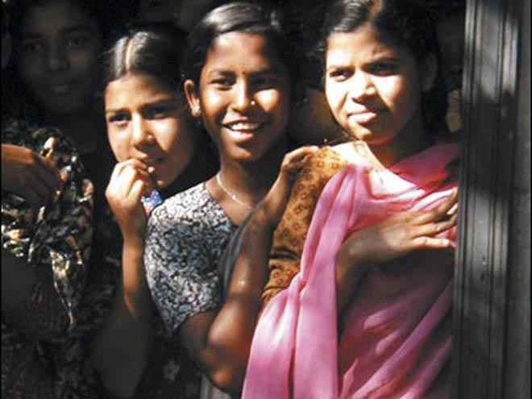
Comprehensive Scheme for Combating Trafficking – Ujjawala
“Ujjawala” is a Comprehensive Central Sector Scheme to combat trafficking, launched on 4th December, 2007. The scheme has five components viz.,Prevention,Rescue, Rehabilitation and Re-Integration of Victims of Trafficking and Commercial Sexual Exploitation”. The fund under the scheme is released to the implementing agencies which mainly includesNGOs. The Government of India share is 90% of the total cost of the project.
Photo Gallery
Audio/Video
Achievements
SWADHAR
WWH
STEP
IGMSY
SABLA
BBBP
NMEW
A total number of 289 projects have been sanctioned as on 30th November, 2014 which includes 165 Rehabilitation Homes.
Ujjawala Webpage
MINISTRY OF WOMEN AND CHILD DEVELOPMENT
GOVERNMENT OF INDIA

Slide 23
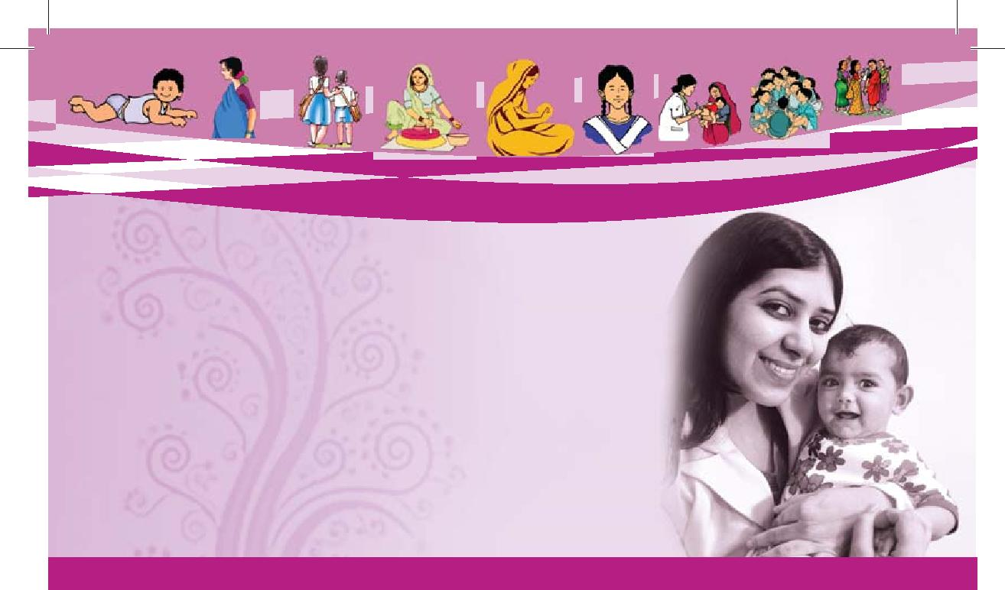
Indira Gandhi Matritva Sahyog Yojana (IGMSY)
IGMSY is a conditional cash transfer scheme for pregnant and lactating women introduced in October 2010 as a 100% Centrally Sponsored Scheme for contributing to a better enabling environment by providing cash incentives to pregnant and nursing mothers. The Scheme is being implemented using the platform of ICDS on pilot basis in 53 selected districts across the country. Under the scheme, maternity benefit @ Rs. 6,000 per beneficiary is being provided to pregnant and lactating mothers 19 years and above for two live births.
Photo Gallery
Audio/Video
Achievements
SWADHAR
WWH
STEP
UJJAWALA
SABLA
BBBP
NMEW
OBJECTIVES OF THE SCHEME
To improve the health and nutrition status of pregnant & lactating women and infants by;
Promoting appropriate practices, care and service utilization during pregnancy, safe delivery and lactation;
Encouraging the women to follow (optimal) IYCF practices including early and exclusive breast feeding for the first six months;
Contributing to better enabling environment by providing cash incentives for improved health and nutrition to pregnant and lactating mothers.
IGMSY Webpage
IGMSY - Web Based Application For Direct Cash Transfer
MINISTRY OF WOMEN AND CHILD DEVELOPMENT
GOVERNMENT OF INDIA

Slide 24
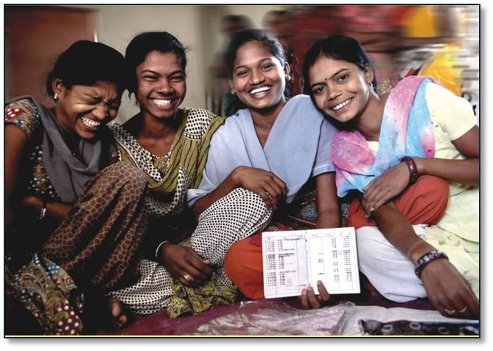
Rajiv Gandhi Scheme for Empowerment of Adolescent Girls (RGSEAB) – SABLA
SABLA, a Centrally Sponsored Scheme was introduced in 2010-11 for holistic development of adolescent girls (11-18 years) making them self-reliant by improving their health and nutrition status and facilitating access to learning and public services through various interventions such as Health, Education, Vocational Training and counseling & guidance at AWC.
Photo Gallery
Audio/Video
Anganwadi Functioning
Achievements
SWADHAR
WWH
STEP
UJJAWALA
IGMSY
BBBP
NMEW
Major Components
Nutrition
Non- Nutrition
Under Nutrition Girls (14-18 years) are provided supplementary Nutrition and under Non Nutrition component, out of school AGs (11-18 years) are provided IFA Supplementation, Health Check-up and Referral services, Counselling/ Guidance on Family Welfare etc.
The scheme is being implemented in 205 selected districts across the country on pilot basis. It is being implemented through the State Govts./UTs with 100 % financial assistance from Central Govt. on all inputs other than nutrition for which 50% is the central assistance. Anganwadi Centre is the focal point for the delivery of services.
RGSEAB-Sabla Webpage
Nearly 100 lakh adolescent girls per annum are benefitted under the scheme.
MINISTRY OF WOMEN AND CHILD DEVELOPMENT
GOVERNMENT OF INDIA

Slide 25



BETI BACHAO BETI PADHAO(BBBP)
The scheme aims to address the issue of Child Sex ratio (CSR) through a National level strategy focusing on mass campaign for improving CSR and promote education in 100 gender critical districts through multi-sectoral action.
Photo Gallery
Audio/Video
Achievements
SWADHAR
WWH
STEP
UJJAWALA
IGMSY
SABLA
NMEW
OBJECTIVES:
Prevent gender biased sex selective elimination
Ensure survival & protection of the girl child
Ensure education of the girl child
DISTRICTS IDENTIFIED:
The 100 districts have been identified on the basis of low Child Sex Ratio as per Census 2011 covering all States/UTs as a pilot with at least one district in each state.
COMPONENTS:
Mass Communication Campaign on Beti Bachao-Beti Padhao.
Multi-Sectoral interventions in 100 Gender Critical Districts covering all States/UTs low on CSR.
||Email id: pmubbbp@gmail.com || Contact No: 011-23381537||
Our Goal: Celebrate the Girl Child & Enable her Education

Slide 26

National Mission for Empowerment of Women (NMEW)
The National Mission for Empowerment of Women (NMEW) was launched by the Government of India(GoI) on International Women’s Day in 2010 with the aim to strengthen overall processes that promote all-round Development of women.
It has the mandate to strengthen the inter-sector convergence; facilitate the process of coordinating all the women’s welfare and socio-economic development programmes across ministries and departments.
The Mission aims to provide a single window service for all programmes run by the Government for Women under aegis of various Central Ministries.
The National Resource Center for Women has been set up which functions as a national convergence center for all schemes and programmes for women. It acts as a central repository of knowledge, information, research and data on all gender related issues and is the main body servicing the National and State Mission Authority.
Poorna Shakti Kendra (PSK) is a model dedicated to helping women access the benefits made available to them through various government programmes. Village coordinators at the Kendras would reach out to the women with the motto “HUM SUNENGE NAARI KI BAAT!” PSKs are operational in three districts in Rajasthan (Pali), Assam (kamrup Metropolitan) and Meghalaya (Jaintia Hills). 19 more districts have also been approved for implementation of PSKs
Photo Gallery
Audio/Video
Achievements
SWADHAR
WWH
STEP
UJJAWALA
IGMSY
SABLA
BBBP
NMEW Webportal
MINISTRY OF WOMEN AND CHILD DEVELOPMENT
GOVERNMENT OF INDIA

Slide 27

CHILDREN SCHEMES
Integrated Child Development Services Scheme (ICDS)
Early Childhood Care and Education(ECCE)
Malnutrition
Rajiv Gandhi National Creche Scheme(RGNCS)
Integrated Child Protection Scheme (ICPS)
Rajiv Gandhi Scheme for Empowerment of Adolescent Boys – Saksham
Scheme for Welfare of Working Children in need of Care and Protection
WOMEN SCHEMES

Slide 28

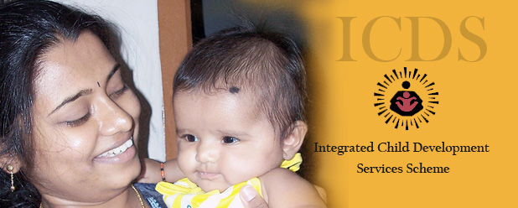
Integrated Child Development Services (ICDS) Scheme
The Integrated Child Development Services (ICDS) Scheme one of the flagship programmes of the Government of India was launched in 1975. This Centrally Sponsored Scheme aims to improve the nutritional and health status of children in the age-group 0-6 years, as well as taking care of pregnant women and nursing mothers. There are 7076 projects and 14 lakh Anganwadi Centres approved by Government of India, across the country. The strengthened and restructured ICDS with an overall budget of Rs.1,23,580 cr. during the 12thFive Year Plan has been rolled out which inter-alia includes addressing the gaps and challenges with special focus on children under 3 years and Pregnant and Lactating mothers, strengthening and repackaging of services including care and nutrition counseling services, provision for additional Anganwadi Worker-cum-Nutrition counselor etc., As regards the financing pattern, the cost sharing ratio between the Centre and the States is 90:10 for all components including SNP for North East, 50:50 for SNP in all States/UTs other than NE and 75:25 for all new components approved under the restructured ICDS.
Photo Gallery
Audio/Video
Anganwadi Functioning
Aanganwadi documentary- Odisha
Achievements
Early Childhood Care and Education(ECCE)
Malnutrition
Rajiv Gandhi National Creche Scheme(RGNCS)
Integrated Child Protection Scheme (ICPS)
Rajiv Gandhi Scheme for Empowerment of Adolescent Boys – Saksham
Scheme for Welfare of Working Children in need of Care and Protection
There are 13.42 operational Anganwadi Centres providing services of supplementary nutrition to about 852.39 lakh children beneficiaries (6months to 6 years) and about 199.13 lakh Pregnant and Lactating mothers as on 30th September, 2014.
ICDS Webpage
SERVICES OFFERED UNDER THE SCHEME
4. immunization,
5. health check-up and
6. Referral services.
supplementary nutrition,
pre-school non-formal education,
nutrition & health education,
MINISTRY OF WOMEN AND CHILD DEVELOPMENT
GOVERNMENT OF INDIA

Slide 29
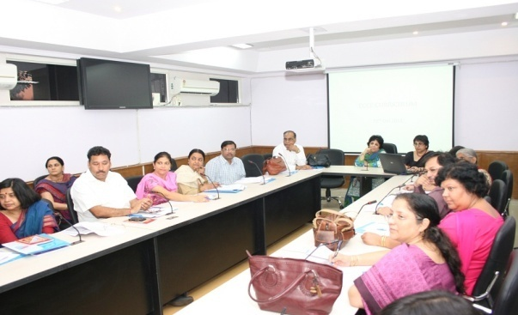

The National Early Childhood Care and Education (ECCE)
Photo Gallery
Audio/Video
Achievements
The Early Childhood Care and Education for children up to 6 years of age focusses on laying foundation for life long development, for enhancing school readiness and human capital formation. Currently ICDS is the largest provider of ECCE in public sector followed by private sector provisions largely concentrated in urban areas but gradually proliferating in rural areas as well as in some States. In recognition of the overwhelming need for affordable and quality early childhood care and education the Ministry has moved
ahead with the policy to achieve holistic development and active learning capacity of all children below 6 years of age by promoting free, universal, inclusive, enjoyable, joyful and contextualized opportunities for laying foundation and attaining full potential.
Integrated Child Development Services Scheme (ICDS)
Malnutrition
Rajiv Gandhi National Creche Scheme(RGNCS)
Integrated Child Protection Scheme (ICPS)
Rajiv Gandhi Scheme for Empowerment of Adolescent Boys – Saksham
Scheme for Welfare of Working Children in need of Care and Protection
National Early Childhood Care and Education Policy
MINISTRY OF WOMEN AND CHILD DEVELOPMENT
GOVERNMENT OF INDIA

Slide 30
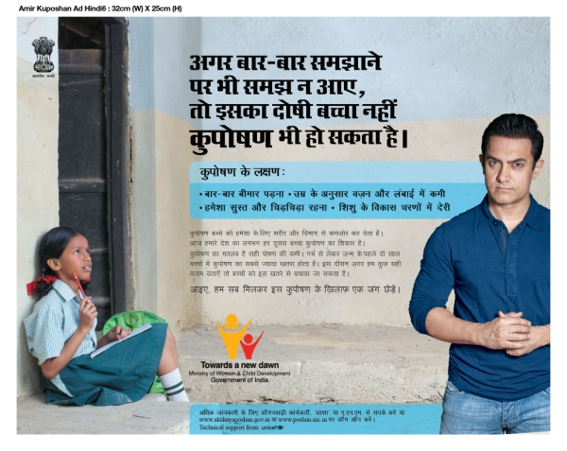
MALNUTRITION
Malnutrition means imbalanced nutrition and includes both under-nutrition and over-nutrition. The problem is multi-dimensional and inter-generational in nature, the determinants of which include food insecurity, illiteracy and lack of awareness especially in women, access to health services, availability of safe drinking water, sanitation etc. Food and Nutrition Board under the Ministry of Women and Child Development with a country wide set up comprising technical wing at centre, four regional offices with quality control laboratories and 43 committee food and nutrition extension units is responsible for policy guidelines for critical nutrition issues and nutrition coordination and improving the content of nutrition programmes.
Further the Government has accorded high priority to the issue of mal-nutrition especially amongst children and young girls and to tackle this problem, a new invigorated National Nutrition Mission is being formulated. The contours and contents are being worked out in consultation with stake-holders, academia experts and representatives of States.
Photo Gallery
Audio/Video
Amir Khan: Free India from Malnutrition-Kuposhan Bharat Chodo
Achievements
Integrated Child Development Services Scheme (ICDS)
Early Childhood Care and Education(ECCE)
Rajiv Gandhi National Creche Scheme(RGNCS)
Integrated Child Protection Scheme (ICPS)
Rajiv Gandhi Scheme for Empowerment of Adolescent Boys – Saksham
Scheme for Welfare of Working Children in need of Care and Protection
Click here for creative's, audios and videos in 18 languages on Information, Education and Communication (IEC) Campaign against malnutrition
MINISTRY OF WOMEN AND CHILD DEVELOPMENT
GOVERNMENT OF INDIA

Slide 31
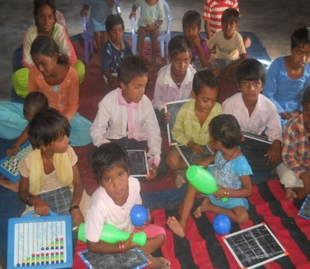
Rajiv Gandhi National Creche Scheme
RGN Creche Scheme was launched as a Central Sector Scheme w.e.f. 1st January, 2006 to provide day care facilities to children (age group of 0-6 years) of working and other deserving women belonging to families whose monthly income is not more than Rs. 12,000/-. The Scheme provides supplementary nutrition, health care inputs like immunization, polio drops, basic health monitoring, recreation, pre-school education (03-06 years), emergency medicine and contingencies.
The scheme is presently implemented through Central Social Welfare Board (CSWB) and Indian Council for Child Welfare (ICCW).The Government assistance is limited to 90% of the schematic pattern or actual expenditure (except honorarium to crèche workers) whichever is less and the remaining expenditure is borne by the implementing agencies concerned. Government grant @ Rs 3,532.00 per month per crèche for 25 babies is given to the implementing agencies.
Photo Gallery
Audio/Video
Achievements
Integrated Child Development Services Scheme (ICDS)
Early Childhood Care and Education(ECCE)
Malnutrition
Integrated Child Protection Scheme (ICPS)
Rajiv Gandhi Scheme for Empowerment of Adolescent Boys – Saksham
Scheme for Welfare of Working Children in need of Care and Protection
Rajiv Gandhi National Creche Scheme-policy document
Total number of beneficiaries during 2013-14 is about 5.88 lakh
MINISTRY OF WOMEN AND CHILD DEVELOPMENT
GOVERNMENT OF INDIA

Slide 32

Integrated Child Protection Scheme (ICPS)
The Integrated Child Protection Scheme was introduced in 2009-10 as a Centrally Sponsored Scheme with the aim to contribute to the improvement in wellbeing of children of difficult circumstances, as well as to the reduction of vulnerabilities to situation and action that lead to abuse, neglect, exploitation, abandonment and separation of children from their families as well as for rehabilitation and reintegration of children in need of care and protection as well as children in conflict with law.
The scheme has been revised w.e.f 1st April, 2014 with improved financial norms for child maintenance in homes, SAAs, Open Shelters, sponsorship, foster care and after care fund. It is Rs. 2000/month/child. The Scheme envisages creating a service delivery network, exclusively for child protection which has been provided with setting-up and maintenance of 34 State Child Protection Societies, 31 State Project Support Unit, 31 State Adoption Resource Agencies and 622 District Child Protection Units in 30 States.
The fund sharing pattern under ICPS between Centre and States are 90:10 under all components in North-East States, Uttrakhand, Jammu & Kashmir and Himachal Pradesh. In rest of India the sharing pattern varies for different components.
Photo Gallery
Audio/Video
Achievements
ICPS Achievements
Child line achievements
Integrated Child Development Services Scheme (ICDS)
Early Childhood Care and Education(ECCE)
Malnutrition
Rajiv Gandhi National Creche Scheme(RGNCS)
Rajiv Gandhi Scheme for Empowerment of Adolescent Boys – Saksham
Scheme for Welfare of Working Children in need of Care and Protection
ICPS Webpage
MINISTRY OF WOMEN AND CHILD DEVELOPMENT
GOVERNMENT OF INDIA

Slide 33
Integrated Child Protection Scheme (ICPS)- contd.
OBJECTIVES OF THE SCHEME
.
Integrated Child Development Services Scheme (ICDS)
Early Childhood Care and Education(ECCE)
Malnutrition
Rajiv Gandhi National Creche Scheme(RGNCS)
Integrated Child Protection Scheme (ICPS)
Rajiv Gandhi Scheme for Empowerment of Adolescent Boys – Saksham
Scheme for Welfare of Working Children in need of Care and Protection
Provide safe and secure environment for children living in difficult circumstances
Reduce vulnerabilities to situations and actions that lead to abuse, neglect, exploitation, abandonment and separation of children from families;
Bring focus on Non-institutional care;
Develop a platform for partnership between Government & Civil Society;
Establish convergence of services
Encourage quicker establishment of structures and procedures under the [JJ Act].
Photo Gallery
Audio/Video
Achievements
ICPS Achievements
Child line achievements
There are 625 Child Welfare Committees (CWCs) and 612 Juvenile Justice Boards (JJBs) as on November, 2014.
Child Helpline Service (1098) has started functioning and the service is now available in 282 districts in the Country.
In addition National Portal for missing and found children named TRACKCHILD is also operational under the Child Tracking System. Under this, 3047 CCI have uploaded the data for child staying therein and matching of 35,146 children has been done as on 30th November, 2014.
ICPS Webpage
MINISTRY OF WOMEN AND CHILD DEVELOPMENT
GOVERNMENT OF INDIA

Slide 34
Rajiv Gandhi Scheme for Empowerment of Adolescent Boys (RGSEAB) – SAKSHAM
Photo Gallery
Audio/Video
Achievements
Integrated Child Development Services Scheme (ICDS)
Early Childhood Care and Education(ECCE)
Malnutrition
Rajiv Gandhi National Creche Scheme(RGNCS)
Integrated Child Protection Scheme (ICPS)
Scheme for Welfare of Working Children in need of Care and Protection
The Ministry has recently launched a new Centrally Sponsored Scheme Saksham for holistic development of adolescent boys. The scheme aims at all round development of adolescent boys to make them self-reliant, gender sensitive and aware citizens, when they grow up. In the first phase, the scheme shall cover all adolescent boys (11-18 years) in 20 selected districts from 8 States benefitting nearly 6 lakh adolescent boys annually. ICDS will be utilized for the scheme Saksham.
MINISTRY OF WOMEN AND CHILD DEVELOPMENT
GOVERNMENT OF INDIA

Slide 35
Scheme for Welfare of Working Children in Need of Care and Protection
This Central Sector Scheme provides opportunities for non-formal education and formal training to working children to facilitate their entry / re-entry into main stream education in cases where they have either not attended any learning system or where, for some reasons, their education has been discontinued. The scheme provides support for holistic development of child workers and potential child workers, especially those with non or ineffective family support such as children of slum, pavement dwellers/drug addicts etc. The Scheme is operated through voluntary sector and NGOs are eligible for financial assistance to the tune of 90% from Government of India.
Photo Gallery
Audio/Video
Achievements
Integrated Child Development Services Scheme (ICDS)
Early Childhood Care and Education(ECCE)
Malnutrition
Rajiv Gandhi National Creche Scheme(RGNCS)
Integrated Child Protection Scheme (ICPS)
Rajiv Gandhi Scheme for Empowerment of Adolescent Boys – Saksham
OBJECTIVE OF THE SCHEME
Provision of opportunities including non-formal education, vocational training, etc, to working children to facilitate their entry/re-entry into mainstream education in cases where they have either not attended any learning system or where for some reasons their education has been discontinued with a view to preventing their continued or future exploitation.
Scheme for Welfare of Working Children in Need of Care and Protection- Webpage
MINISTRY OF WOMEN AND CHILD DEVELOPMENT
GOVERNMENT OF INDIA

Slide 36
Autonomous Bodies under Ministry
National Commission for Women (NCW)
National Commission for Protection of Child Rights(NCPCR)
National Institute of Public Cooperation and Child Development (NIPCCD)
Rashtriya Mahila Kosh (RMK)
Central Adoption Resource Authority (CARA)
Central Social Welfare Board (CSWB)
WOMEN SCHEMES
CHILDREN SCHEMES

Slide 37

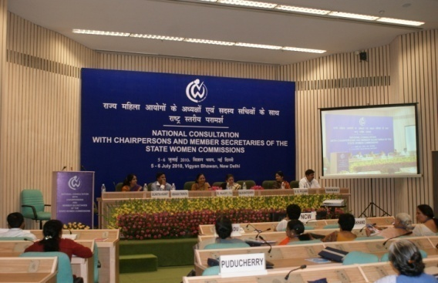
National Commission for Women(NCW)
Photo Gallery
Audio/Video
Achievements
National Commission for Protection of Child Rights(NCPCR)
National Institute of Public Cooperation and Child Development (NIPCCD)
Rashtriya Mahila Kosh (RMK)
Central Adoption Resource Authority (CARA)
Central Social Welfare Board (CSWB)
The National Commission for Women was set up in January, 1992 to review the Constitutional and Legal safeguards for women; recommend remedial legislative measures ; facilitate redressal of grievances and advise the Government on all policy matters affecting women.
NCW Webportal
MINISTRY OF WOMEN AND CHILD DEVELOPMENT
GOVERNMENT OF INDIA

Slide 38
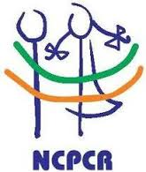

National Commission for Protection of Child Rights(NCPCR)
Photo Gallery
Audio/Video
Achievements
National Commission for Women (NCW)
National Institute of Public Cooperation and Child Development (NIPCCD)
Rashtriya Mahila Kosh (RMK)
Central Adoption Resource Authority (CARA)
Central Social Welfare Board (CSWB)
The National Commission for Protection of Child Rights (NCPCR) was set up in March, 2007 to ensure that all Laws, Policies, Programmes, and Administrative Mechanisms are in consonance with the Child Rights perspective as enshrined in the Constitution of India and also the UN Convention on the Rights of the Child. The Child is defined as a person in the 0 to 18 years age group.
NCPCR Webportal
MINISTRY OF WOMEN AND CHILD DEVELOPMENT
GOVERNMENT OF INDIA

Slide 39

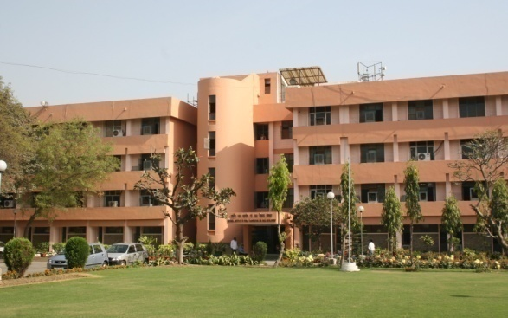
National Institute of Public Cooperation and Child Development (NIPCCD)
Photo Gallery
Audio/Video
Achievements
National Commission for Women (NCW)
National Commission for Protection of Child Rights(NCPCR)
Rashtriya Mahila Kosh (RMK)
Central Adoption Resource Authority (CARA)
Central Social Welfare Board (CSWB)
NIPCCD, set up in New Delhi in 1966 is devoted to promotion of voluntary action research, training and documentation in the overall domain of women and child development. The Institute, over a period of time, has established four Regional Centres at Guwahati, Bangalore, Lucknow and Indore.
The Institute provides training to the functionaries of the Integrated Child Development Services (ICDS) programme and at national and regional level, under the Integrated Child Protection Scheme (ICPS).
NIPCCD Webportal
MINISTRY OF WOMEN AND CHILD DEVELOPMENT
GOVERNMENT OF INDIA

Slide 40

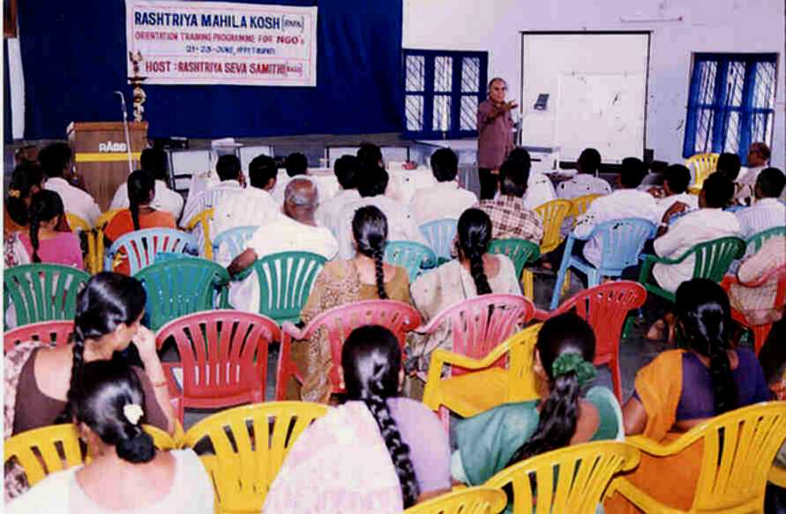
Rashtriya Mahila Kosh(RMK)
Photo Gallery
Audio/Video
Achievements
National Commission for Women (NCW)
National Commission for Protection of Child Rights(NCPCR)
National Institute of Public Cooperation and Child Development (NIPCCD)
Central Adoption Resource Authority (CARA)
Central Social Welfare Board (CSWB)
RashtriyaMahilaKosh (RMK) was established in 1993 for socio-economic empowerment of women. RMK provides loans to NGO-MFIs termed as Intermediary Organisations (IMO) which on-lend to Self Help Groups (SHGs) of women. In addition, RMK also has appointed nodal agencies and franchisees for furthering of its objectives of reaching out to the women beneficiaries with easy access of micro credit for income generating activities.
RMK Webportal
MINISTRY OF WOMEN AND CHILD DEVELOPMENT
GOVERNMENT OF INDIA

Slide 41


Central Adoption Resource Authority (CARA)
Photo Gallery
Audio/Video
Achievements
Central Adoption Resource Authority (CARA) is an autonomous body under the Ministry of Women & Child Development, Government of India. It functions as the nodal body for adoption of Indian children and is mandated to monitor and regulate in-country and inter-country adoptions.
CARA is designated as the Central Authority to deal with inter-country adoptions in accordance with the provision of the Hague Convention on Inter-country Adoption, 1993, ratified by Government of India in 2003.
CARA primarily deals with adoption of orphan, abandoned and surrendered children through its associated / recognized adoption agencies. The improvements and simplification of procedures are being carried out. New Guidelines has been prepared by the Ministry are now in the public domain which would make adoption easier, simpler and speedier.
National Commission for Women (NCW)
National Commission for Protection of Child Rights(NCPCR)
National Institute of Public Cooperation and Child Development (NIPCCD)
Rashtriya Mahila Kosh (RMK)
Central Social Welfare Board (CSWB)
CARA Webportal
MINISTRY OF WOMEN AND CHILD DEVELOPMENT
GOVERNMENT OF INDIA

Slide 42

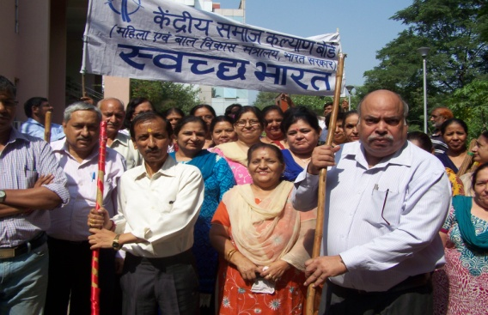
Central Social Welfare Board(CSWB)
Photo Gallery
Audio/Video
Achievements
National Commission for Women (NCW)
National Commission for Protection of Child Rights(NCPCR)
National Institute of Public Cooperation and Child Development (NIPCCD)
Rashtriya Mahila Kosh (RMK)
Central Adoption Resource Authority (CARA)
The Central Social Welfare Board was set up in 1953 with the objective of promoting social welfare activities and implementing welfare programmes for women and children through voluntary organisations. The State Social Welfare Boards have been set up in 33 States and UTs. The Board has been making concerted efforts for empowerment of women through Family Counselling Centre Programme, Short Stay Home, Awareness Generation Programme, Condensed Courses of Education for Adult Women and other Support Services.
CSWB Webportal
MINISTRY OF WOMEN AND CHILD DEVELOPMENT
GOVERNMENT OF INDIA

Slide 43
RECENT EVENTS
International Participation
Beti Bachao Beti Padao (BBBP)
Toilets in Anganwadi Centres
Malnutrition
Juvenile Justice (Care and Protection of Children) Bill, 2014
Child Line (1098)
Adoption
Bal Swachh Diwas
Exhibition on ‘Women of India’ at Dilli Haat, INA, New Delhi
National Awards

Slide 44
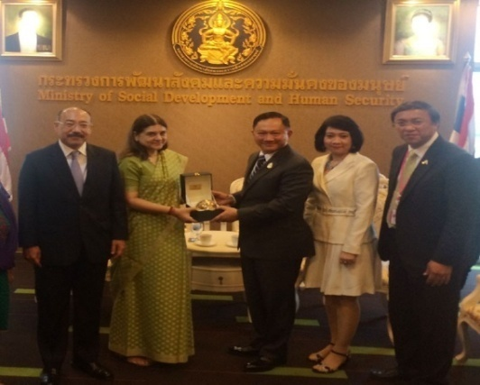
International Participation
a) Asian and Pacific Conference on “Gender Equality and Women’s Empowerment : Beijing+20 Review”
Smt. Maneka Sanjay Gandhi, Minister, WCD represented Ministry of Women and Child Development, Government of India in the Asian and Pacific Conference on “Gender Equality and Women’s Empowerment : Beijing+20 Review” held during 17-20 November, 2014.
Minister, WCD showcased India’s achievement on gender equality at the Conference. It was informed that women in India are marching ahead rapidly to become equal contributors in economic and social development of the national and aiming at setting foot print on the world. The Conference was attended by over 700 delegates including some heads of Governments including Ministers and representatives of the civil society.
In addition to above, the Ministry was also represented at the following International events :
UN Committee of the Rights of the Child (UNCRC) held in Geneva, Switzerland from 30th May, 2014 to 3rd June, 2014.
SAIEVAC-SAACH Regional Consultation held in Kathmandu, Nepal from 25-27 May, 2014.
3rd Session of the Committee on Social Development held in Bangkok, Thailand from 18-20 August, 2014
UN Committee on CEDAW held in Geneva, Switzerland from 29th June, 2014 to 2nd July, 2014.
CODEX Shadow Committee Meeting held in Geneva, Switzerland from 14-18 July, 2014.
5th Governing Board Meeting of the South Asia Initiative to End Violence Against Children (SAIEVAC) held in Dhaka, Bangladesh from 19-21 August, 2014.
18th SAARC Summit and its preceding meetings for discussion of matters relating to constitute a Gender Policy Advocacy Group (SAARC-GPAG) held in Kathmandu, Nepal on 25th November, 2014.
Beti Bachao Beti Padao (BBBP)
Toilets in Anganwadi Centres
Malnutrition
Juvenile Justice (Care and Protection of Children) Bill, 2014
Child Line (1098)
Adoption
Bal Swachh Diwas
Exhibition on ‘Women of India’ at Dilli Haat, INA, New Delhi
National Awards
.
The Union Minister for Women and Child Development, Smt. Maneka Sanjay Gandhi and the Minister for Social Development and Human Security, Thailand, Mr. Adul Saengsingkaew, at a bilateral meeting, during the “Asia and Pacific Conference on Gender Equality and Women’s Empowerment: Beijing+20 Review”, at Bangkok on November 19, 2014.

Slide 45
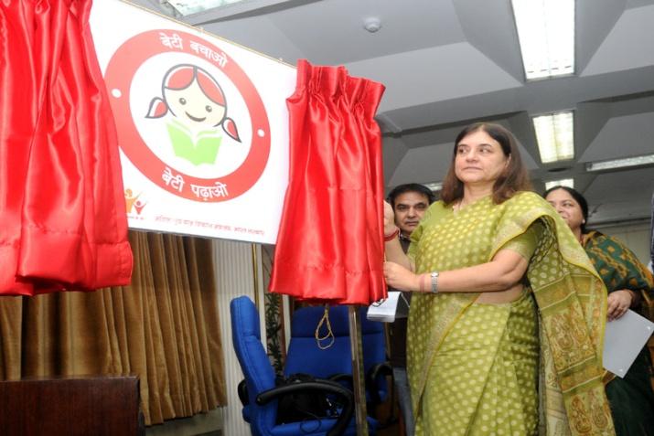
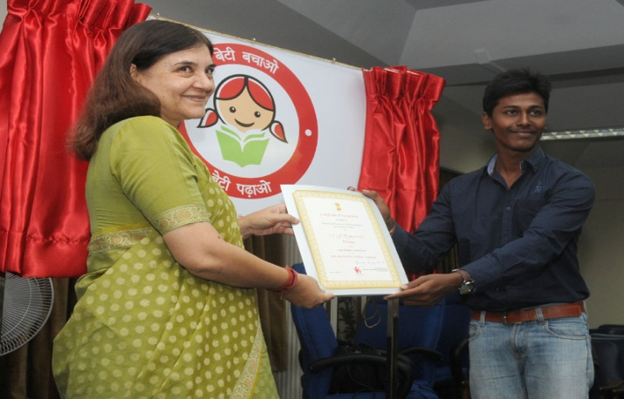
BETI BACHAO BETI PADHAO(BBBP)
The Government of India has introduced Beti Bachao Beti Padao (BBBP) scheme for survival, protection and education of girl child. It aims to address the issue of declining child sex ratio through a mass campaign across the country. The scheme is a joint initiative of Ministry of Women and Child Development, Ministry of Health and Family Welfare and Ministry of Human Resource Development.
The logo for the BBBP scheme was finalized through an All India Competition. Finally the logo prepared by a young student Shri A.G. Raghavendra from Hyderabad was selected and the same was unveiled by Minister, WCD on 17th Sept. 2014.
Photo Gallery
Audio/Video
Achievements
International Participation
Toilets in Anganwadi Centres
Malnutrition
Juvenile Justice (Care and Protection of Children) Bill, 2014
Child Line (1098)
Adoption
Bal Swachh Diwas
Exhibition on ‘Women of India’ at Dilli Haat, INA, New Delhi
National Awards
Hon’ble Union Minister for Women and Child Development, Smt. Maneka Sanjay Gandhi releasing a logo “Beti Bachao Beti Padhao”, at a press conference, in New Delhi on September 17, 2014
The Union Minister for Women and Child Development, Smt. Maneka Sanjay Gandhi felicitating Shri Raghavendra from Hyderabad, award winner of Logo Design Competition of “Beti Bachao Beti Padhao” campaign, at a press conference, in New Delhi on September 17, 2014.

Slide 46
Toilets in Anganwadi Centres
Photo Gallery
Audio/Video
Achievements
International Participation
Beti Bachao Beti Padao (BBBP)
Malnutrition
Juvenile Justice (Care and Protection of Children) Bill, 2014
Child Line (1098)
Adoption
Bal Swachh Diwas
Exhibition on ‘Women of India’ at Dilli Haat, INA, New Delhi
National Awards
Construction of Anganwadi Centres with toilets has become a programme component of ICDS recently. Under the strengthened and restructured ICDS, construction of 2 lakh AWC buildings has been approved and construction of toilets is an integral part of the AWC buildings to be constructed. Further upgradation of 2 lakh AWC buildings would also have at least one toilet, where toilets are not available.
MINISTRY OF WOMEN AND CHILD DEVELOPMENT
GOVERNMENT OF INDIA

Slide 47

MALNUTRITION
International Participation
Beti Bachao Beti Padao (BBBP)
Toilets in Anganwadi Centres
Juvenile Justice (Care and Protection of Children) Bill, 2014
Child Line (1098)
Adoption
Bal Swachh Diwas
Exhibition on ‘Women of India’ at Dilli Haat, INA, New Delhi
National Awards
Photo Gallery
Audio/Video
Achievements
Tackling Malnutrition amongst children and women in 200 high burden districts through need based multi-nutrition programme.
The Government has identified 200 high burden districts in the country for tackling malnutrition amongst women through community based management programme. Special camps known as Sneha Shivirs are being held in these districts for the prevention and management of moderate and severe under nutrition.
Under this programme, Sneha Shivirs are to be serviced through an Additional Anganwadi Worker/Nutrition Counsellor at the Anganwadi Centre. The aim is to ensure quick rehabilitation of undernourished children, enable families to sustain rehabilitation, and prevent future under nutrition by changing behaviors in child care, feeding and health seeking.
During 2014-15, 2,07,189 Sneha Shivir camps have been sanctioned till November, 2014.
The Union Minister for Women and Child Development, Smt. Maneka Sanjay Gandhi addressing the inaugural session of "Consultation on National Nutrition Mission in India: Accelerating Essential Nutrition Actions", in New Delhi on September 22, 2014.

Slide 48
Juvenile Justice (Care and Protection of Children) Bill, 2014
Photo Gallery
Audio/Video
Achievements
International Participation
Beti Bachao Beti Padao (BBBP)
Toilets in Anganwadi Centres
Malnutrition
Child Line (1098)
Adoption
Bal Swachh Diwas
Exhibition on ‘Women of India’ at Dilli Haat, INA, New Delhi
National Awards
The Government has introduced a comprehensive legislation providing measures for children in need of care and protection and children in conflict with law. The offences have been clearly defined and classified in the bill as petty, serious and heinous. Special provisions have been made to tackle child offenders committing heinous offences in the age group of 16-18 years. The Bill also proposes to place such children in place of safety both during and after trial till they attain the age of 21 years. After completing 21 years of age, if the Court feels that child has not undergone any reformation and change, then the child is to be shifted to jail meant for adults. The bill to this effect has been introduced in the Parliament and it is expected that enactments of this Bill will act as a deterrent for child offenders committing heinous offences.
MINISTRY OF WOMEN AND CHILD DEVELOPMENT
GOVERNMENT OF INDIA

Slide 49
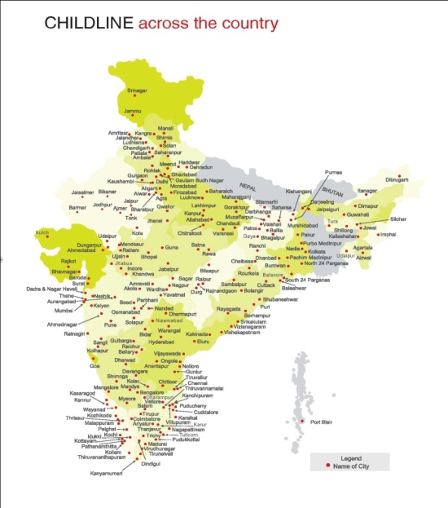
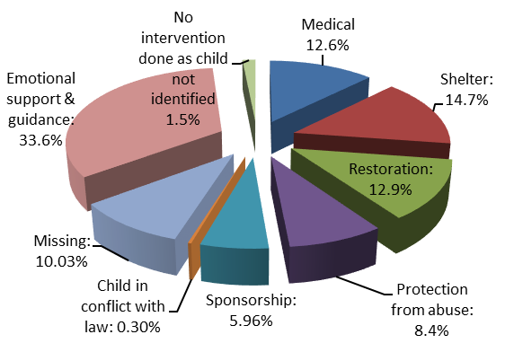
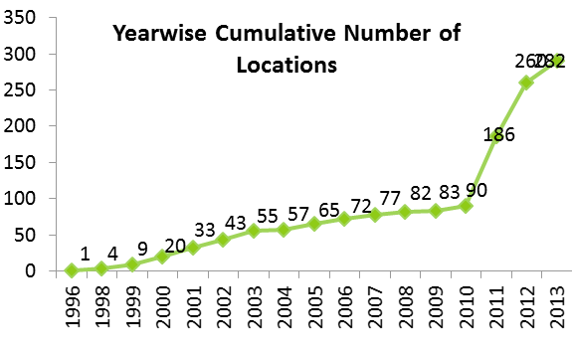
CHILDLINE(1098)
International Participation
Beti Bachao Beti Padao (BBBP)
Toilets in Anganwadi Centres
Malnutrition
Juvenile Justice (Care and Protection of Children) Bill, 2014
Adoption
Bal Swachh Diwas
Exhibition on ‘Women of India’ at Dilli Haat, INA, New Delhi
National Awards
This is an emergency 24 hour toll free outreach service for children in need of care and protection. Currently the service is available in 282 locations and is likely to be expanded to 343 locations by the end of Financial Year 2014-15. Approximately, 38 lakh calls were received in 2013-14. The kind of calls received including medical help, emotional support and guidance, protection from abuse, shelter, missing children, restoration of children in verdict with law. The Child line services currently operated by single centralized call centre at Mumbai is being expanded to 3 other centralized call centres at Chennai, Kolkata and Gurgaon.
MINISTRY OF WOMEN AND CHILD DEVELOPMENT
GOVERNMENT OF INDIA

Slide 50
ADOPTION
International Participation
Beti Bachao Beti Padao (BBBP)
Toilets in Anganwadi Centres
Malnutrition
Juvenile Justice (Care and Protection of Children) Bill, 2014
Child Line (1098)
Bal Swachh Diwas
Exhibition on ‘Women of India’ at Dilli Haat, INA, New Delhi
National Awards
Photo Gallery
Audio/Video
Achievements
In the area of adoption, the Ministry has taken significant steps in the last few months in 2013-14. New guidelines prepared and available on public domain is to make adoption easier, simpler and speedier. An important change is that the entire process will be carried out on-line prior to placing the case finally before the Court of Law. In 2013-14, the number of adoption was 1100. This year during the period June to August 1650 adoption has been carried out.
MINISTRY OF WOMEN AND CHILD DEVELOPMENT
GOVERNMENT OF INDIA

Slide 51
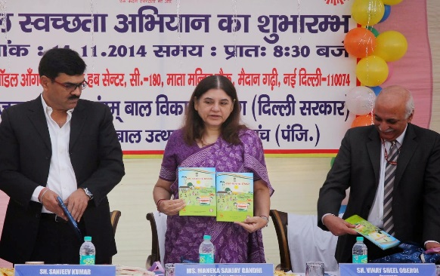
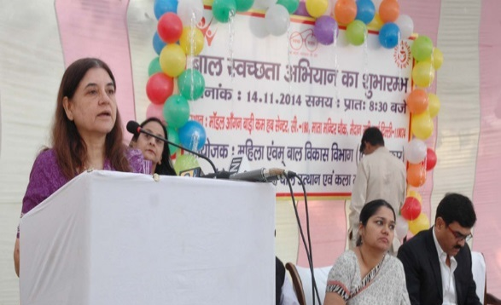
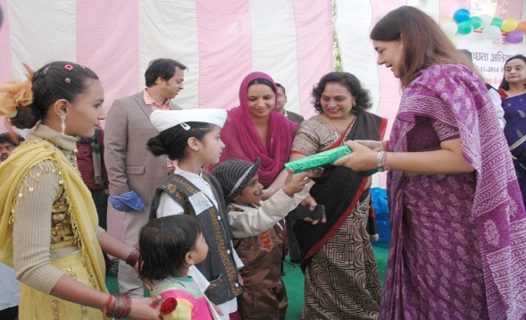
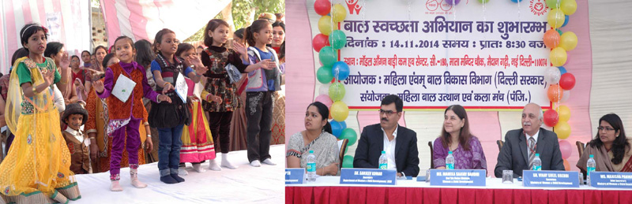
BAL SWACHH DIWAS
A booklet on Bal Swachhata Mission – Swachh Bharat SwachhAnganwadiin English & Hindi was also released by Smt. Maneka Sanjay Gandhi, Hon’ble Minister, WCD on the occasion of ‘Bal Divas’ on 14th November, 2014.
International Participation
Beti Bachao Beti Padao (BBBP)
Toilets in Anganwadi Centres
Malnutrition
Juvenile Justice (Care and Protection of Children) Bill, 2014
Child Line (1098)
Adoption
Exhibition on ‘Women of India’ at Dilli Haat, INA, New Delhi
National Awards
The Union Minister for Women and Child Development, Smt. Maneka Sanjay Gandhi addressing at the launch of the Bal Swachhta Mission, in New Delhi on November 14, 2014.
The Union Minister for Women and Child Development, Smt. Maneka Sanjay Gandhi presenting the gifts to the children, at the launch of the Bal Swachhta Mission, in New Delhi on November 14, 2014.
Photo Gallery
Audio/Video
Achievements
The Union Minister for Women and Child Development, Smt. Maneka Sanjay Gandhi watching the performance of the children, at the launch of the Bal Swachhta Mission, in New Delhi on November 14, 2014.

Slide 52
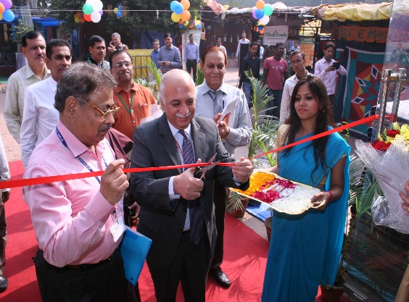
Exhibition on ‘Women of India’ at Dilli Haat, INA, New Delhi
Photo Gallery
Audio/Video
Achievements
International Participation
Beti Bachao Beti Padao (BBBP)
Toilets in Anganwadi Centres
Malnutrition
Juvenile Justice (Care and Protection of Children) Bill, 2014
Child Line (1098)
Adoption
Bal Swachh Diwas
National Awards
The Ministry of Women and Child Development organized ‘Women of India’ Exhibition at Dilli Haat, INA, New Delhi from 13th – 19th November, 2014. The aim of the Exhibition was to empower rural women artisans and provide platform for their economic empowerment. Success stories of Eminent Women of India were highlighted in the panels.
In all 205 organizations from all over India exhibited their products and handicrafts.
The Union Minister for Women and Child Development, Smt. Maneka Sanjay Gandhi visiting the Women of India Exhibition, at Dilli Haat, in New Delhi on November 14, 2014.
MINISTRY OF WOMEN AND CHILD DEVELOPMENT
GOVERNMENT OF INDIA

Slide 53
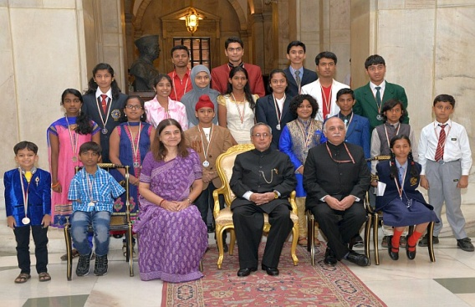
NATIONAL AWARDS
International Participation
Beti Bachao Beti Padao (BBBP)
Toilets in Anganwadi Centres
Malnutrition
Juvenile Justice (Care and Protection of Children) Bill, 2014
Child Line (1098)
Adoption
Bal Swachh Diwas
Exhibition on ‘Women of India’ at Dilli Haat, INA, New Delhi
In order to support and encourage the voluntary sector, the Government of India has started a Scheme for giving National Awards to deserving institutions and individuals for their outstanding performance in the field of child development and welfare.
For further details on eligibility criteria / procedure and award details kindly go through MoWCD website
The Ministry of Women and Child Development organized award ceremony for National Child Awards for Exceptional Achievement – 2014, Rajiv Gandhi ManavSeva Award-2014 and National Awards for Child Welfare – 2013 on November, 14, 2014 at RashtrapatiBhavan, New Delhi. The function was presided over by Shri Pranab Mukherjee, Hon’ble President of India who presented the awards. Smt. Maneka Sanjay Gandhi, Hon’ble Minister, WCD was present in the function.
Photo Gallery
Audio/Video
Achievements
-List of Awardees
21 children were felicitated for their exceptional achievement. Besides, 3 awards were given away under Rajiv Gandhi ManavSeva Award. Further, 4 Institutions and 3 individuals were also selected and given away award under the Scheme of National Awards for Child Welfare.
MINISTRY OF WOMEN AND CHILD DEVELOPMENT
GOVERNMENT OF INDIA

Slide 54

Ministry of Women and Child Development
Shastri Bhawan, Rajendra Prasad Road
New Delhi -110 001

